Slide 1
Cypriot PV Industry Experience
Fanos Karantonis
Chairman of Cyprus Association of Renewable Energy Enterprises

Slide 2
Cyprus Association of Renewable Energy Enterprises
History
The Cyprus Association of renewable Energy Enterprises was founded in 2004 and it is a member of the Federation of Employers and Industrialists. Its members are companies and professionals, registered in Cyprus, that are activated in the RES Sector.
Scope
The promotion of the use of energy from renewable energy sources in the Republic of Cyprus and the establishment of stable and prospective investment environment.
Mission
SEAPEK aims to contribute positively and productively towards the compliance of Cyprus with the European Energy Policy and the transfer of European Directives into the national legislation
National energy legislation pillars,
The promotion of the use of energy from renewable energy sources, Energy Targets 2020 (2009/28/EC)
Energy efficiency of buildings, NZEB (2010/31/EC)
Energy Efficiency (2012/27/EC)
Fanos Karantonis – SEAPEK Chairman

Slide 3
Strengthening investor confidence?
Cyprus has chosen to promote renewable energy technologies and energy conservation by adopting annual Support Schemes.
These Support Schemes although they assist the investment have not been able to create a stable investment environment.
Also have not been able to maintain permanent green jobs.
Fanos Karantonis – SEAPEK Chairman

Slide 4
The example of RES enterprises - Cyprus
Total number of employees in companies operating in the renewable energy technologies (2011-2014)
854
660
582
485
Source: Cyprus Energy Agency and SEAPEK (2014)
Fanos Karantonis – SEAPEK Chairman

Slide 5
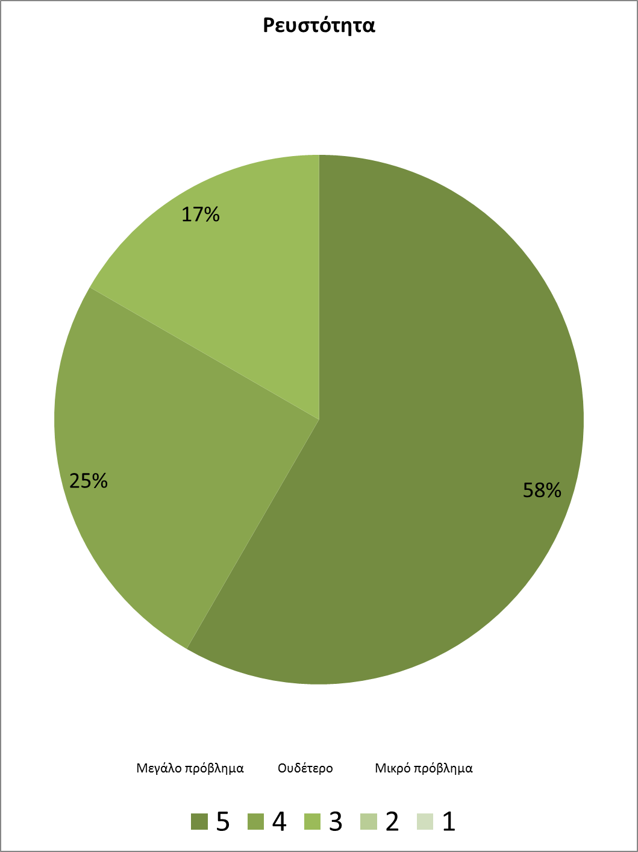
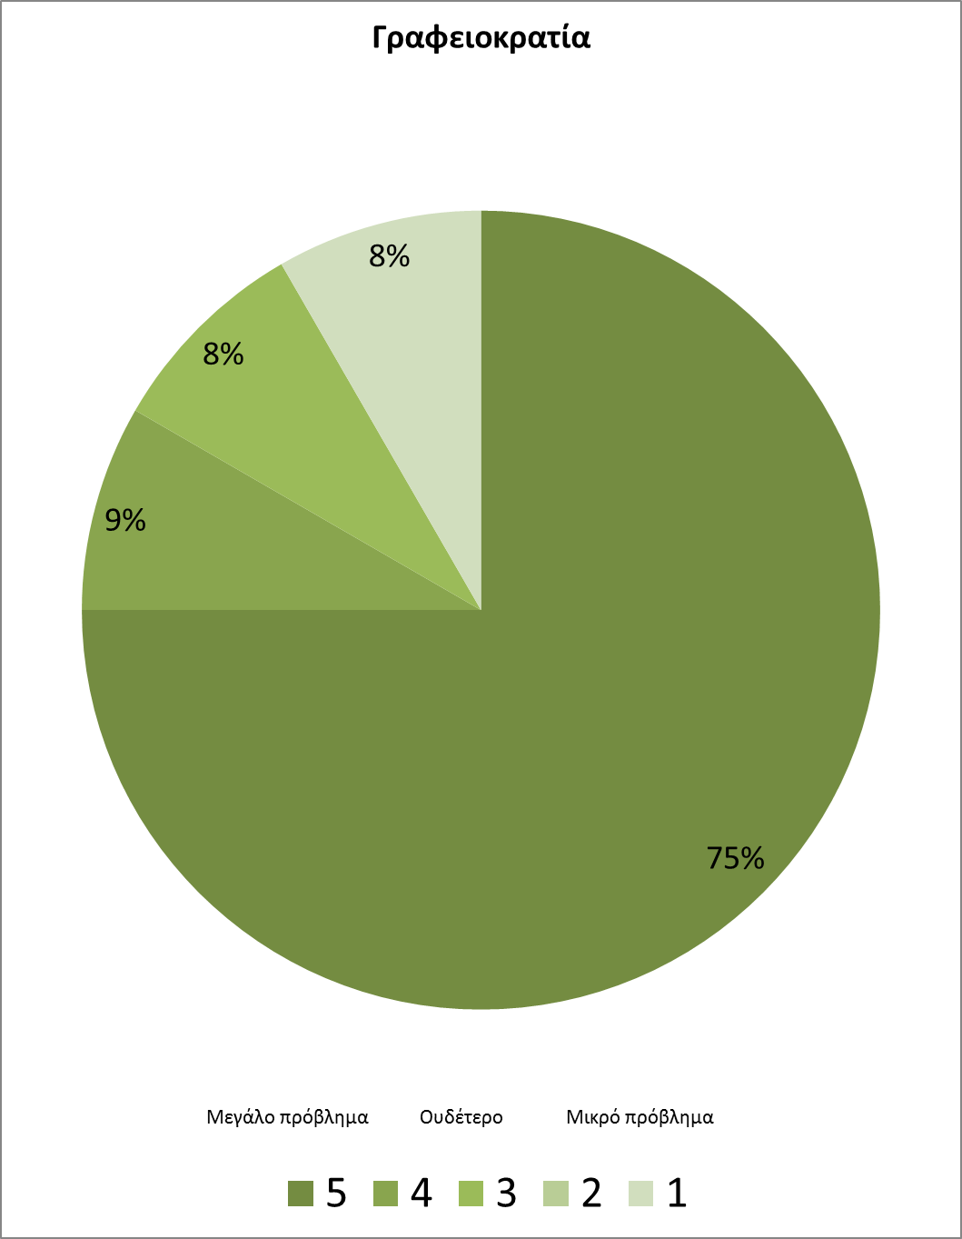
The example of RES enterprises - Cyprus
The problems facing enterprises in Cyprus operating in the filed of renewable technologies
Source: Cyprus Energy Agency and SEAPEK (2014)
Fanos Karantonis – SEAPEK Chairman

Slide 6
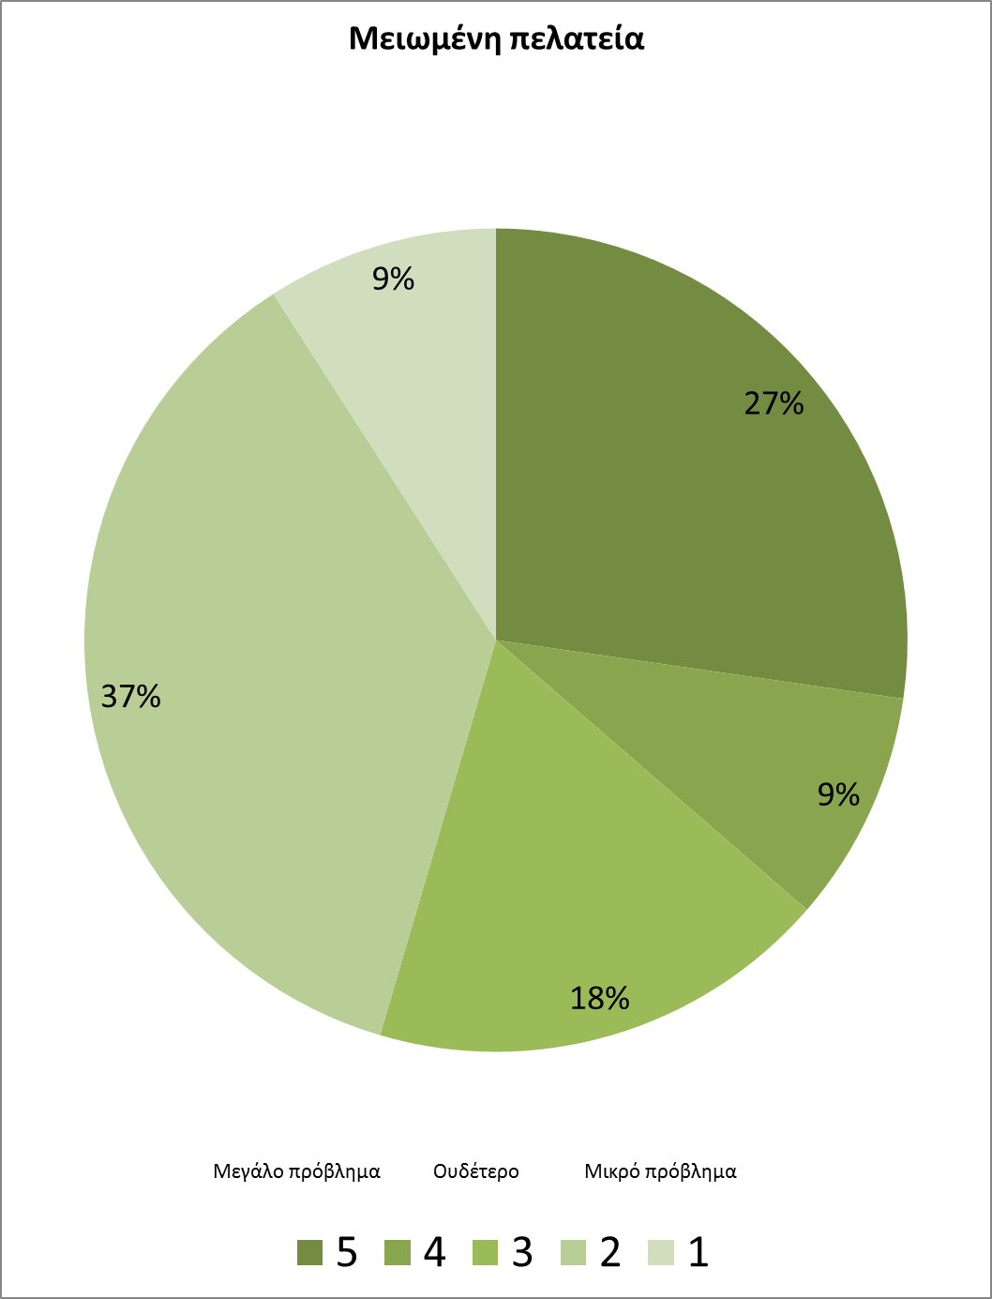
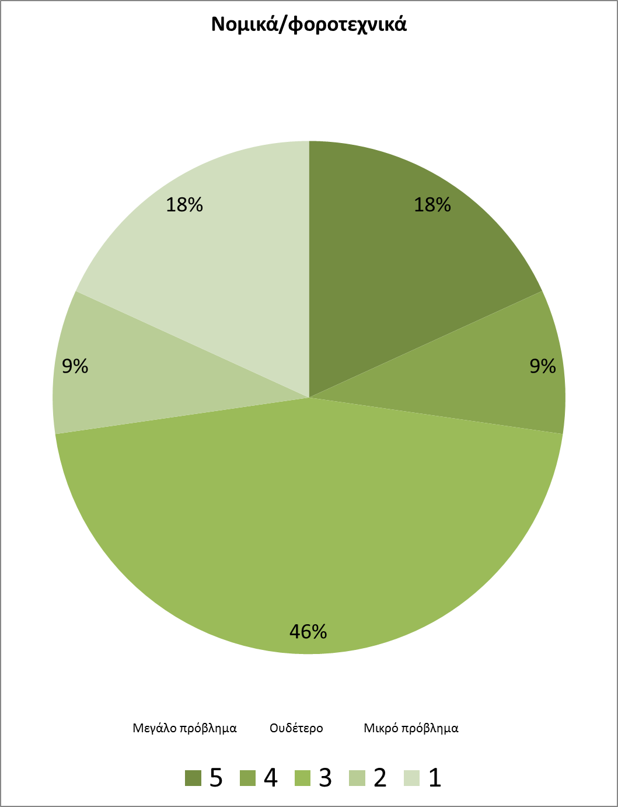
The example of RES enterprises - Cyprus
The problems facing enterprises in Cyprus operating in the filed of renewable technologies
Source: Cyprus Energy Agency and SEAPEK (2014)
Fanos Karantonis – SEAPEK Chairman

Slide 7
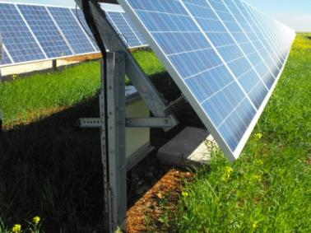
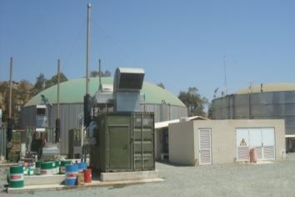
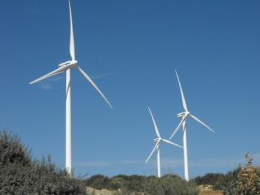
Evolution of RES installations
To achieve the national targets for RES share in final energy consumption 13% by 2020, is expected a rapid development of RES projects (small or large in Cyprus). The target for renewable electricity by 2020 is 16%.
According to the National Action Plan for Renewable Energy in Cyprus target for total installed capacity of PV systems is 192 MW.
Fanos Karantonis – SEAPEK Chairman

Slide 8
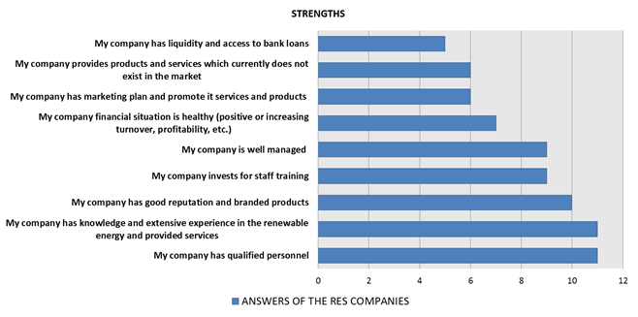
Cyprus RES companies position
A. Internal Aspects (STRENGTHS and WEAKNESSES) of Cyprus RES companies
Fanos Karantonis – SEAPEK Chairman

Slide 9
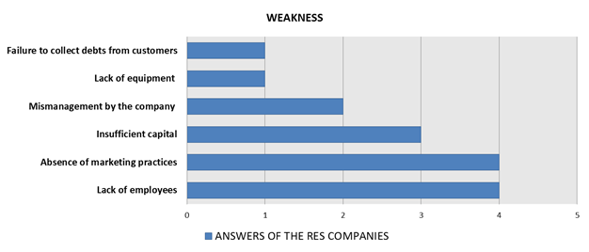
Cyprus RES companies position
A. Internal Aspects (STRENGTHS and WEAKNESSES) of Cyprus RES companies
Fanos Karantonis – SEAPEK Chairman

Slide 10
Cyprus RES companies position
The STRENGTHS of the Cypriot RES companies can be summarized to the extensive experience and knowledge of the RES sector and to the trained –qualified local personnel.
On the other hand, the WEAKNESSES can be summarized to the lack of personnel (lack of capital to hire personnel) and marketing practices for promoting their products.
Fanos Karantonis – SEAPEK Chairman

Slide 11
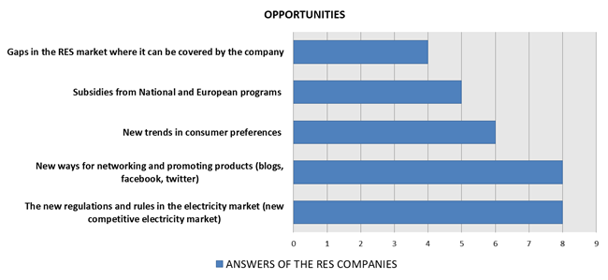
Cyprus RES companies position
B. External Aspects (OPPORTUNITIES and THREATS) of Cyprus RES companies
Fanos Karantonis – SEAPEK Chairman

Slide 12
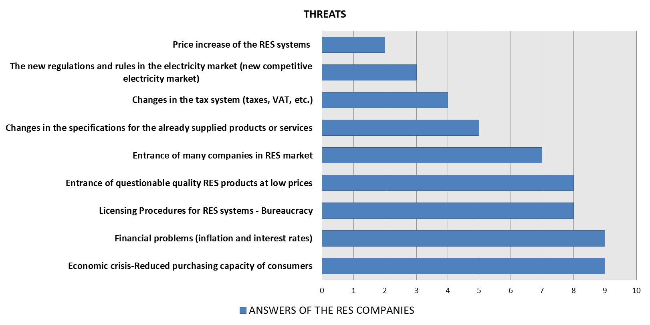
Cyprus RES companies position
B. External Aspects (OPPORTUNITIES and THREATS) of Cyprus RES companies
Fanos Karantonis – SEAPEK Chairman

Slide 13
Future of PV Industry in Cyprus
Today in Cyprus there are 88 active companies that import PV systems. The PV market in Cyprus is considered to be complete.
There is however potential for PV systems imports, in case the electricity market will be fully liberalised and the PV electricity can be provided to the electricity grid through the market rules.
Fanos Karantonis – SEAPEK Chairman

Slide 14
Competitive advantage & disadvantage of Cyprus PV companies
 | Cyprus companies
Companies liquidity and access to loans/capital | ❒
Market share | 
Marketing and advertising | ❒
Good reputation to consumers/ distribution channels | 
Branded products | 
Experience in RES | 
Qualified local personnel | 
Profit margin | 
Fanos Karantonis – SEAPEK Chairman

Slide 15
Thank you!
Fanos Karantonis
'f.karantonis@karantonis.com.cy‘
www.seapek.org.cy

